Slide 1


IOT-BASED GARDENING SENSOR(IGS)
BY DRAGOON WORKS
Team members: Sounak Dey
Track: Classic Tech Track

Slide 2
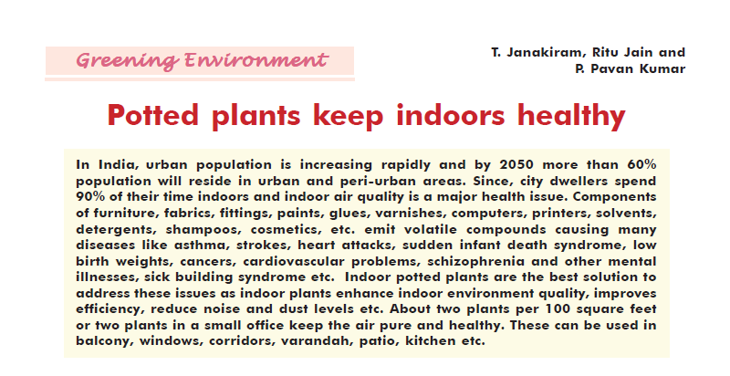
Problem statement
Potted plants indoors are very helpful in keeping indoors healthy and cool in this ever-changing weather. It is also said in an article from The Hindu that the hobby of gardening has been booming across India amid the pandemic. But it still has the following challenges:
root restriction
pest and diseases
waterlogging, etc.

Slide 3
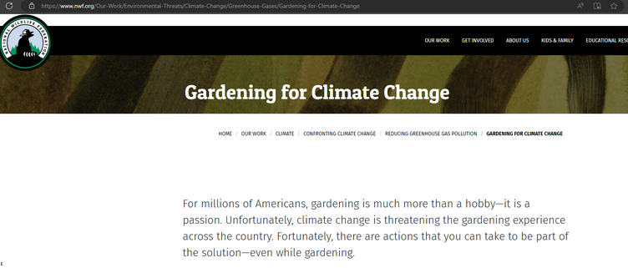
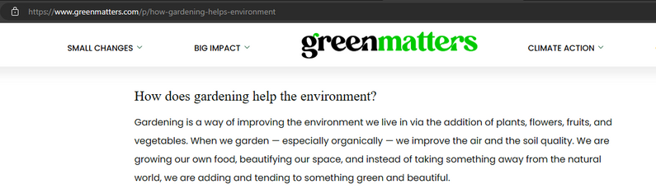
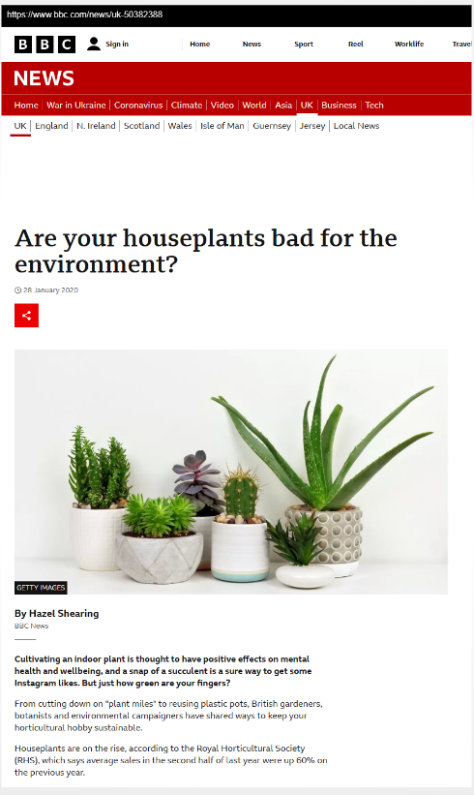
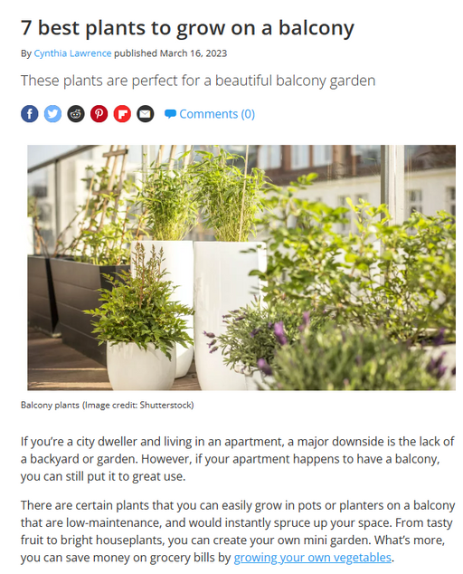
WHY SOLVE IT
Here are some reports on how gardening help with environmental issues:
According to Green Matters, gardening can also provide food security, biodiversity, and mental health benefits for the gardener and their communities.
According to National Wildlife Federation (NWF), gardening for climate change can help the environment by reducing carbon pollution, creating wildlife habitats, conserving water, and promoting native plants.
According to Tom’s Guide, balcony gardening can help the environment by improving air quality, reducing noise pollution, lowering energy consumption, and enhancing urban aesthetics. Balcony gardeners can also grow their own herbs, vegetables, and fruits, which can reduce their carbon footprint and food waste.
According to BBC News, houseplants can help the environment by removing significant amounts of CO2 in a room, depending on the type of plant, how many plants there are, and how well they are maintained. Houseplants can also improve indoor air quality by filtering out harmful chemicals, bacteria, or dust particles.

Slide 4
INTRODUCTION OF THE PRODUCT
IGS fork
IGS App
It is a fork-like user-friendly handle
It can tell the user of the soil moisture value and the humidity in the atmosphere.
It helps by sending the app those values making it easier for the user's understanding
These are available in two variations
It will tell the user about their plants' condition and requirements
It will be able to recommend methods to boost the plant health
It will recommend methods to prevent pests and fertilizers to boost further plant growth
It will also recommend potted plants according to user's needs.

Slide 5
Transportable Handle
Stationary Handle
IGS Fork
Soil Moisture sensor
It is a fork-like user-friendly handle
It can tell the user of the soil moisture value and the humidity in the atmosphere.
It helps by sending the app those values making it easier for the user's understanding
These are available in two variations
Transportable; that can be used for multiple plants
Stationary; that can be used to monitor a plant constantly with least human interaction
Humidity sensors
Grip to hold the handle
Solar Panel for lasting without human interaction

Slide 6

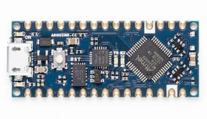

Transportable Handle
Stationary Handle
Takes moisture from the soil and creates number value and is sent to Arduino circuit board
The values sent from the senders are forwarded to the transmitter
Soil Moisture sensor
Arduino circuit board
Miniature solar back for plant specific models
It is a fork-like user-friendly handle
It can tell the user of the soil moisture value and the humidity in the atmosphere.
It helps by sending the app those values making it easier for the user's understanding
These are available in two variations
Transportable; that can be used for multiple plants
Stationary; that can be used to monitor a plant constantly with least human interaction
Humidity sensor
Battery/ power supply
Transmitter
Takes the humidity of the atmosphere and creates a number value and is sent to Arduino circuit board
The forwarded values are sent to the app/ user

Slide 7

Soil Moisture sensor
Working Principle
Data Transfer
Power Transfer
Data to send back to app
App in the user's device
Arduino circuit board
Bluetooth Transmitter
The sensors send the Moisture of the soil and the humidity of the atmosphere to the Arduino board which sends those values to the user's app and then the app predicts how much water to give to the plant by following some set of rules
Data Transfer
Humidity sensor

Slide 8


The transmitter sends signals that will only send to the user in their app using unique code generation

Slide 9
The app will provide a user-friendly method for the user to understand what to do next
The features of the app are:
Range at which they must water the plant and when not using the data from the handle
It will recommend plants for indoor potted plants
It will show methods and medicine to get rid of pests and improve plant health
A community of like nature loving people

Slide 10
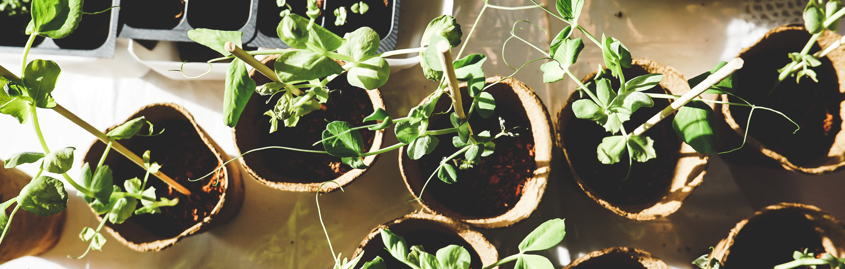
The IGS Fork helps the user to tackle the water requirement problem. It will notify the user of the water that the plant has in the pot and the water the plant has to absorb from the air through the software.
On the other hand, the software takes the information from the hardware and recommends methods to make it suitable for the plant, it also provides methods or medicine against pests and fertilizers to boost plant growth.
The problem my product address

Slide 11
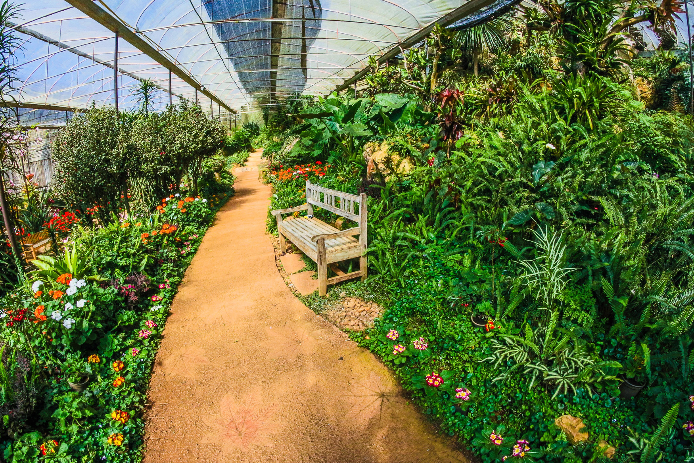
Product features
Problems this product addresses
1.Water logging
2.Water needed
The soil moisture sensor will notify the app which will advise methods to prevent water logging now and in the future.
The humidity sensor will notify the app if there is a chance of rain and whether to water the plant or not for the day
3.Pest Control
4.Plant recommendation
The app will have a page of advice for the user to prevent pests and protect their plant
The app will have a page to recommend to the user any indoor plants or potted plants according to his requirements.

Slide 12


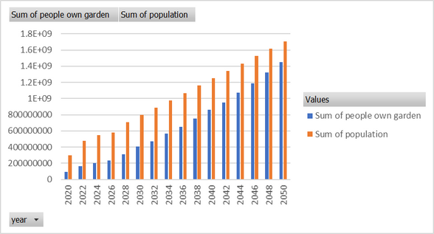
Market Opportunity and Competitive Landscape
and Go-to-Market Strategy and Funding Ask
Future
The ever-growing population of India along with the popularizing idea of eco-friendliness the product can have a good future
Funding
Growth
The product production cost may come to around ₹800 and can be sold for ₹900.
Also in-app ads can add further to the profits
Due to the large popularity of gardening among the middle class and people of India, the product has a large growable market.

Slide 13
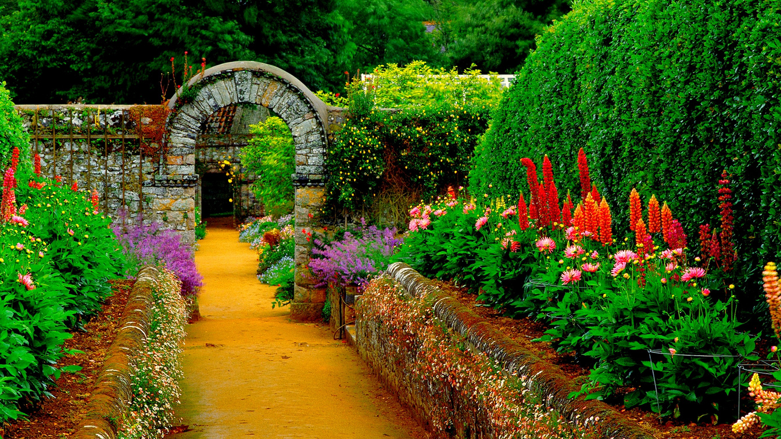
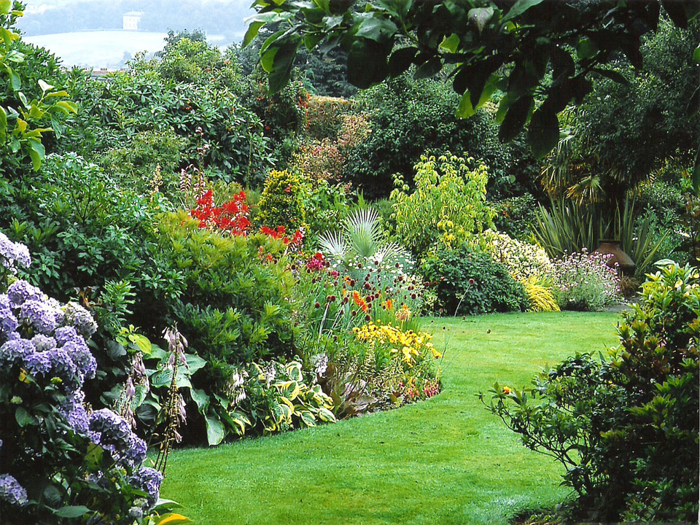
Reports
HINDU REPORT
Problems people face with potted plants
PLANT STRESS
Problems faced by plants being in a pot
GREEN MATTERS REPORT
Benefits of Gardening
BBC NEWS ARTICLE
Benefits of house plants/ indoor plants
Links/Report evidence

Slide 14
Thank
you!

